Slide 1
THE ABYSSAL SQUID
Protecting oceans and securing Bluefin tuna through smart, eco-friendly cleanup technology.
Janakiraman,Harikrishnan
Vekaria,Devin
Bishoi, Pratyush
Period 3-4 Science
6-4-2026

Slide 2
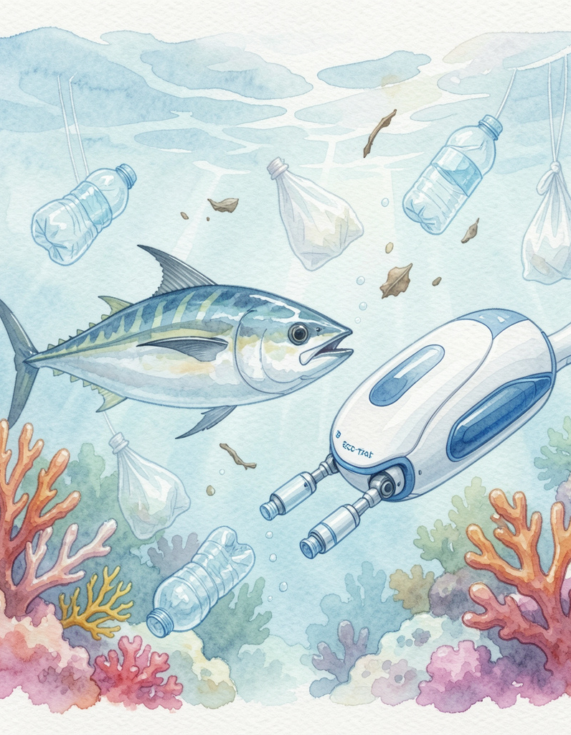
Introduction
The ocean is at a tipping point, and Bluefin tuna face direct threats from pollution. THE ABYSSAL SQUID is a nature-first robotic system designed to remove plastics and restore marine health.
Join us in turning cleanup into conservation—innovative, safe, and scalable.

Slide 3
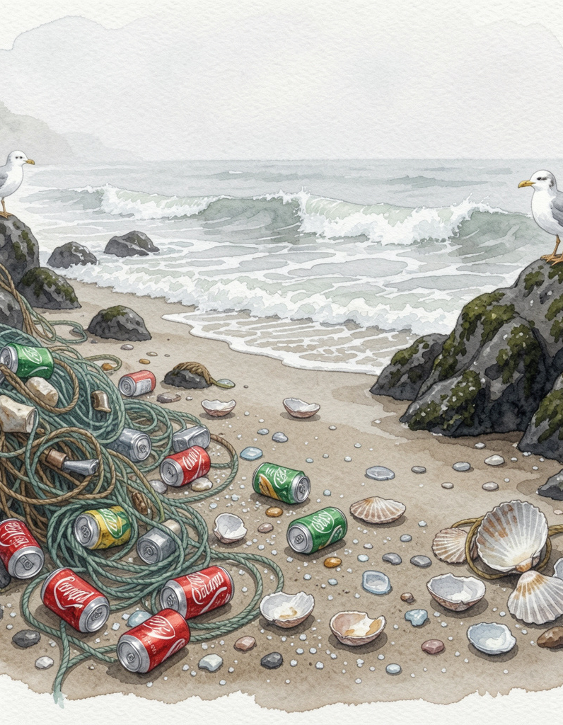
01
Problem & Impact

Slide 4
Plastic Pollution
Over 8 million tons of plastic enter the ocean yearly, seeding microplastics into every food chain.
THE ABYSSAL SQUID targets surface and micro debris with gentle collection, reducing ingestion risk for marine species and lowering long-term contamination. 8 million tons underscores urgency.

Slide 5
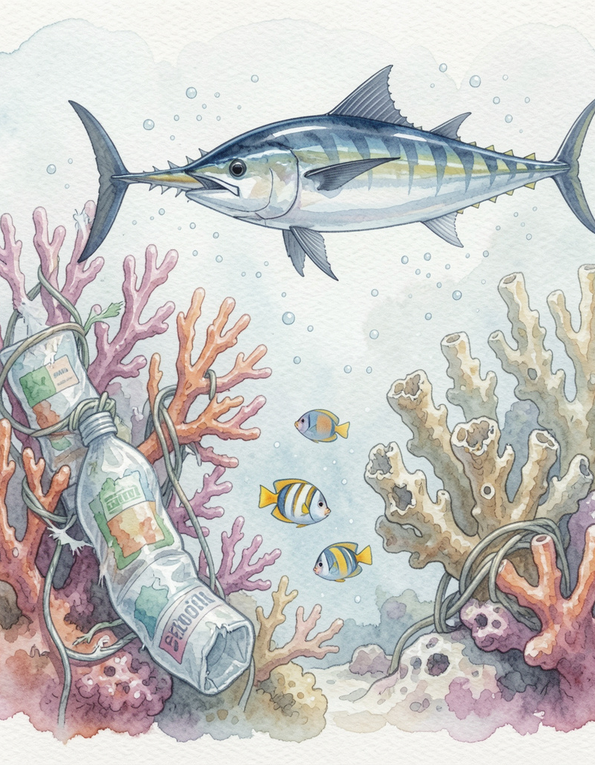
Marine Effects
Plastic and habitat damage poison wildlife, break coral reefs, and threaten fisheries. Bluefin tuna face bioaccumulation and food-chain collapse.
THE ABYSSAL SQUID works with currents to remove pollutants safely, protecting habitats and supporting Bluefin survival while restoring ecosystem balance.

Slide 6
Bluefin Threat
Bluefin tuna face declining populations due to pollution, overfishing, and habitat loss. Microplastics enter their food chain, causing long-term health and reproduction issues.
Eco action now protects food webs and fisheries. Bluefin survival is critical for ocean balance and coastal livelihoods.

Slide 7
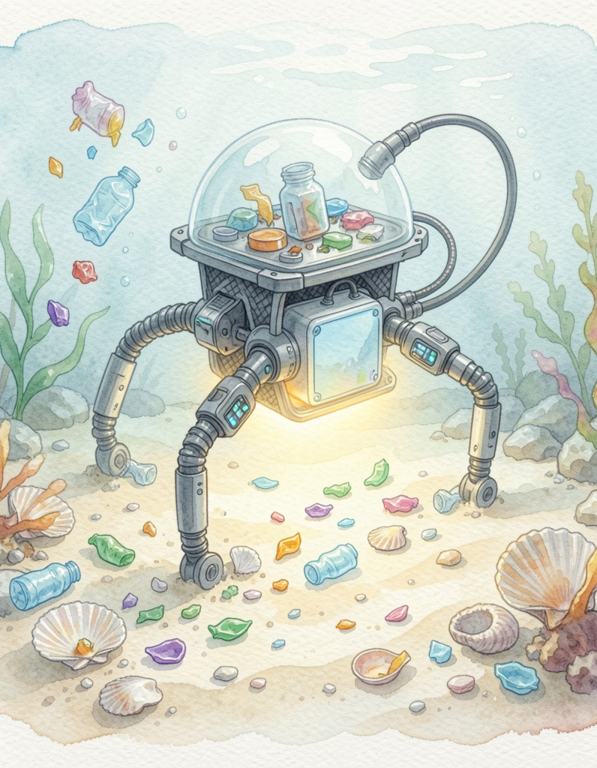
02
THE ABYSSAL SQUID
Solution

Slide 8
Design Overview
Abyssal Squid is a robotic, ocean-friendly cleaner that moves with currents to collect surface and micro debris without harming wildlife.
Its passive collection tentacles and smart navigation focus cleanup where it's most needed, scaling from local bays to open seas.

Slide 9
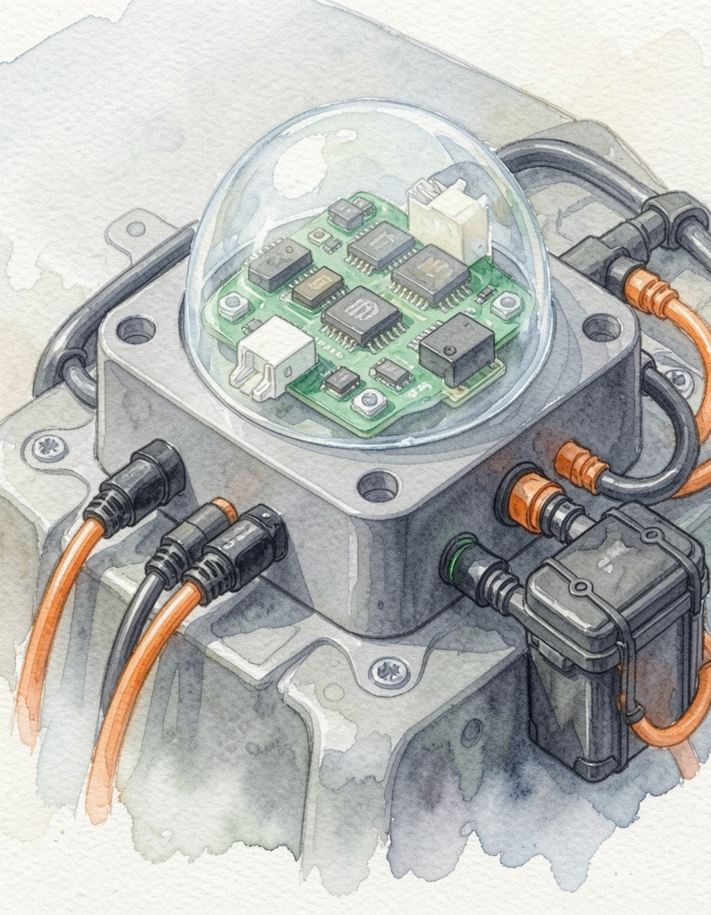
Control Center
The control head houses navigation, power, and processing: Arduino-based control, waterproof dome, and battery pack.
Sensors guide safe routes and target pollution hotspots while protecting coral and marine life through intelligent avoidance.

Slide 10
Sustainability
Built from recycled materials and non-toxic components, THE ABYSSAL SQUID operates without fuel and minimizes disturbance to ecosystems.
Designed for long-term deployment and easy maintenance, it supports circular solutions and community-led conservation. Zero-fuel footprint promotes true sustainability.

Slide 11
Intelligence
With Pristine AI, an purpose built AI that is trained by humans, Abyssal Squid calculates the type of plastics, such as the difference between floating plastics that have just been dumped and microplastics that even the most observant creatures can’t detect.

Slide 12
Our Offer
We are offering a 20% equity stake in our company for an investment of $67,500 to launch a scalable bio-mimicking ocean purification fleet.
By manufacturing a specialized fleet of 1,400 "squid" units at a highly optimized cost of $96.35 per unit, we can completely filter 8,000,000 tons of ocean water in under a year. Each individual squid unit autonomously purifies 16 tons of water per day. With half of our total project funding already secured through a strategic partnership with Team Seas, we are looking for a final partner to bridge the remaining $67,500 gap and deploy this fleet globally.
THE MATH
Manufacturing Cost
1,400 units × $96.35 = $134,890 (Budget: $135,000)
Daily Fleet Capacity
1 unit = 16 tons per day
1,400 units × 16 tons = 22,400 tons per day
Purification Timeline
8,000,000 tons ÷ 22,400 tons per day = 357.14 days
Investment Breakdown
Total needed: $135,000
Team Seas: $67,500
Your investment: $67,500
Equity: 20%

Slide 13
Conclusions
THE ABYSSAL SQUID offers a scalable, nature-aligned path to reduce plastics and protect Bluefin tuna.
Join the movement to restore ocean health—innovate, deploy, and preserve our marine future.

Slide 14
We would be truly honored to partner with you, and we wish you every success ahead.
We hope you will give us funds to clean your home!
Eco-TankSquid@gmail.com
+(676) - 676 6767
https://sites.google.com/mymail.lausd.net/abyssal-squid/abyssal-squid
Sources
The Ocean Cleanup
Everwave
Arduino Starting Guide
Museum of New Zealand Te Papa

